Slide 1
Output devices

Slide 2
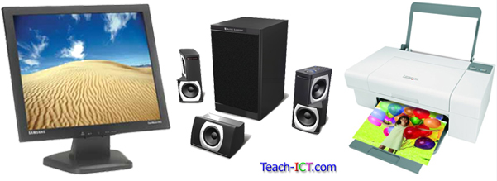
Introduction
In this lecture we will talk about Output device.
Output device are very useful.
For example monitor, printer and speakers.

Slide 3
Monitors
A computer monitor is an electronic device that shows pictures.
Monitors often look similar to televisions.
The main difference between a monitor and a television is that a monitor does not have a television tuner to change channels.
Monitors often have higher display resolution than televisions. A high display resolution makes it easier to see smaller letters and fine graphics.
Picture on monitor are made out of thousands of color dots called pixels
Pixel: The pixel is the basic element of computer display or computer image.
Pixel Term comes from the words Picture Element it is also called (PEL).
pixels are arranged in rows and columns.
The pixels are so close together that they appear
Higher the pixel higher the quality.
By zooming picture you can see the pixels.
.

Slide 4
Continue………………….
Resolution: The clarity or sharpness of a display screen is called its resolution;
the more pixels there are per square inch, the better resolution.
E.g., 640x480, 800x600, 1024x768, 1280x1024, 1600x1280
Types of monitor
Cathode ray tube (CRT)
Flat-panel Displays

Slide 5
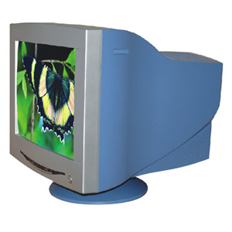
Cathode ray tube-CRT
Large in size
Produce a lot of heat
Noisy compare to flat panel
Glass screen
CRT are outdated
The CRT in a computer display is similar to the "picture tube" in a television .

Slide 6
Flat-panel Displays
Flat-panel are much thinner, weight less, and consume less power. Thus, they are better for portable smart tools.
LCD: Liquid-Crystal Display
LCD is a flat display technology used in laptops, cell phones, and in flat screen displays like TV.
LCD displays utilize two sheets of polarizing material with a liquid crystal solution between them.
The LCD does not refresh like a traditional CRT monitor,
LCDs are used in a wide range of applications including computer monitors, televisions, instrument panels, aircraft displays, clocks, and watches.

Slide 7
LED- light-emitting diodes
An LED TV uses less power.
provides a brighter display and less heat than LCD TV.
This is because an LED TV uses light-emitting diodes for backlighting .
Plasma TV
A plasma display panel (PDP) is a type of flat panel display common to large TV. They are called "plasma" displays because the technology utilizes small cells containing electrically charged ionized gases
A plasma display is a computer video display in which each pixel on the screen is illuminated by a tiny bit of plasma or charged gas
It consumes more power than led. It also heavier than led.

Slide 8

Printers
They are use to create a hard copy of your work.
Most printer produce work on paper.
There are 4 type of printer
Laser printers
Ink-jet printers
Dot-matrix printers
Plotters

Slide 9
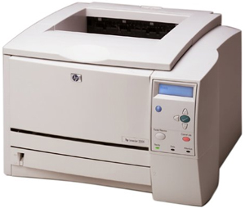
Laser printer
Print large number of sheets very quickly and they produce high quality documents.
Used powdered ink called toner
Cost per page is low
Most expensive printer to buy
Toner are more expensive than ink-jet cartridges.
Larger than ink-jet
Can’t create carbon copies like the dot-matrix.

Slide 10
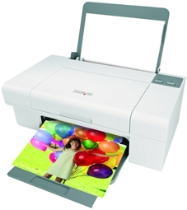
Ink jet Printers
Cheap to buy
Can combine both black and white and colour printing at the same time
Use cartridges which contain ink
Useful for few document needed and the quality of the printout doesn’t need to be perfect.
Cartridges cost less to replace than toners.
Better quality than dot-matrix
Slower than laser
Noiser than laser
Cartridges need to be replace more often than laser
Cartridges can dry out

Slide 11
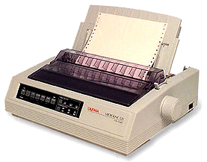
Dot-matrix
Impact printer
Different combination of pins are pushed out to form different characters.
Very noisy
Cheap to buy
Low operating cost
Can print continuously
Create carbon copies
Poor quality
Very slow to print
Noisy
Cannot produce colour copies.

Slide 12
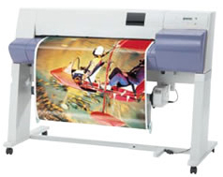
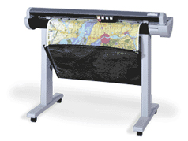
Plotters
Specialist type of printer which able to draw high quality image over a very large piece of paper.
Used by engineers, architects and map-makers.
Larger sizes of paper can be used than most printers
Slower than other printer
More expensive than printer.

Slide 13
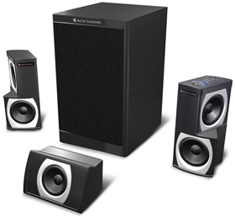
Speakers
It is a hardware output device connected to a computer's sound card that outputs sounds generated by the computer.
Most computer fit a small internal speakers which will produce a beeping sound when you made an error.
Everyone in the room can hear output from computer.
Help blind people to use computer
High quality speakers can be expensive

